Slide 1

Leveraging Large Language Models for Document Extraction in Financial Contexts
USING LLMS TO EXTRACT KEY VALUE PAIRS FROM DOCUMENTS: A NOVEL APPROACH
Presenter's Name: Pramod Gupta
Student ID: 1096494 Final Thesis Presentation for Master in Machine Learning & Artificial Intelligence Liverpool John Moores University & upGrad March 2024

Slide 2
Introduction
In today's rapidly evolving technological landscape, the accurate extraction of information from documents plays a pivotal role in various domains, particularly in the financial sector
This presentation delves into a comprehensive evaluation of the efficacy of Large Language Models in document extraction within financial contexts
By leveraging advanced natural language processing techniques, we aim to shed light on the capabilities and limitations of LLMs in this critical task
Our investigation focuses on notable LLMs such as ChatGPT 3.5, Gemini 1.0, Gemini Vision 1.0, and various configurations of LLAmla2, ranging from 7 to 70 billion parameters
The selected document types for evaluation include the W2, W8, and W9 forms, each representing distinct challenges in information extraction within financial documents
Through this exploration, we aim to contribute valuable insights to the broader field of document extraction and natural language processing

Slide 3

Problem Statement
Manual processing of complex documents (e.g., W-2, W-8, W-9 forms) is time-consuming and error-prone.
Businesses and individuals need efficient and accurate ways to extract key information for summarization.

Slide 4
The Potential of Large Language Models
LLMs (like ChatGPT, Gemini, LLAmla2) have shown remarkable abilities in natural language understanding and processing.
They can be leveraged for automated document extraction tasks.

Slide 5

Research Questions
Which LLM models perform best for specific documents (W-2,
W-8, W-9) and fields?
Can LLMs effectively extract data from different document types?
What are the limitations of LLMs in this context, and how can they be addressed?

Slide 6
AIM & OBJECTIVE
AIM
“To evaluate the efficacy of different Large Language Models in accurately extracting information from financial documents”
LLM Performance Evaluation: Analyze ChatGPT 3.5, Gemini models, and LLAmla2 configurations for accurate data extraction from financial documents.
Format-Specific Assessment: Examine LLM efficacy across W2, W8, and W9 forms to pinpoint strengths and limitations within the financial context.
OBJECTIVE
Evaluate
Assess
Compare
Provide
Field-Level Accuracy Comparison: Compare LLM performance in extracting data like EINs, SSNs, and wages to understand model nuances.
Future Research Recommendations: Propose directions for refined LLM training, ensemble learning, human-in-the-loop systems, bias mitigation, expanded document scope, and real-world applications.

Slide 7

Literature Review
Historical Evolution: Named Entity Recognition (NER) has undergone significant evolution over the past three decades, from early rule-based linear models to the emergence of sophisticated deep learning techniques.
Dominance of Supervised Learning: Supervised learning techniques, including Hidden Markov Models, Maximum Entropy Models, and Conditional Random Fields (CRFs), dominated the NER landscape in the late 1990s and early 2000s, driven by standardization initiatives like MUC and CONLL.
Deep Learning Revolution: The advent of deep learning marked a significant paradigm shift in NER, with neural network architectures such as Recurrent Neural Networks (RNNs) and Transformer models demonstrating superior capabilities in capturing complex features from data.
Emegence of Large Language Models (LLMs) and Prompt Engineering: Recent advancements in NER have been propelled by the rise of Large Language Models (LLMs) like GPT and BERT, accompanied by the emerging field of prompt engineering, which guides LLMs towards desired outputs, thereby enhancing their performance in NER tasks.

Slide 8
Evolution from Rule Based to LLM
Older works
Seq2Seq Encoder-Decoder Models
Transformer based model
GPT and other LLM
Rule-Based Linear Models - Rau, 1991
Standardization and Annotated Corpora - Grishman & Sundheim, 1996
Supervised Learning Techniques - Sarawagi & Cohen, 2004
Semi-CRF and Lexicon-Infused Skip-Gram Models - Passos et al., 2014
Joint Models and Multitask Learning - Durrett & Klein, 2014
Neural Machine Translation by Jointly Learning to Align and Translate - Bahdanau et al., 2014
Sequence to Sequence Learning with Neural Networks - Sutskever et al., 2014
Google's Neural Machine Translation System: Bridging the Gap between Human and Machine Translation - Wu et al., 2016
Convolutional Sequence to Sequence Learning - Gehring et al., 2017
Attention Is All You Need - Vaswani et al., 2017
BERT: Pre-training of Deep Bidirectional Transformers for Language Understanding - Devlin et al., 2018
Roberta: A Robustly Optimized BERT Pretraining Approach - Liu et al., 2019
Albert: A Lite BERT for Self-Supervised Learning of Language Representations - Lan et al., 2020
Language Models are Few-Shot Learners - Brown et al., 2020
Improving Language Understanding by Generative Pretraining - Radford et al., 2018
Language Models are Few-Shot Learners - Brown et al., 2020
The GPT-3 architecture - Brown et al., 2020
Exploiting Cloze Questions for Few-Shot Text Classification and Natural Language Inference - Schick & Schütze, 2021

Slide 9
MOdels & Techniques
Pre-Trained Language Models
GPT-3
Third generation of GPT (upto 175B params). (Brown et al., 2020)
GPT-3.5
GPT-3 + Instruction Tuning. Based on InstructGPT. (Ouyang et al., 2022; OpenAI, 2023b)
Gemini-pro
Gemini-Vision-pro
LLAMA2 ( 7b to 70b)
Open Foundation and Fine-Tuned Chat Models(Hugo Touvron et al., 2023; Meta, 2023b)
Released By Google, 2023
Released By Google, 2023
n-Shot Learning
Few-Shot Learning
Few reference samples (~10)
One-Shot Learning
One reference sample
Zero-Shot Learning
Zero reference samples

Slide 10
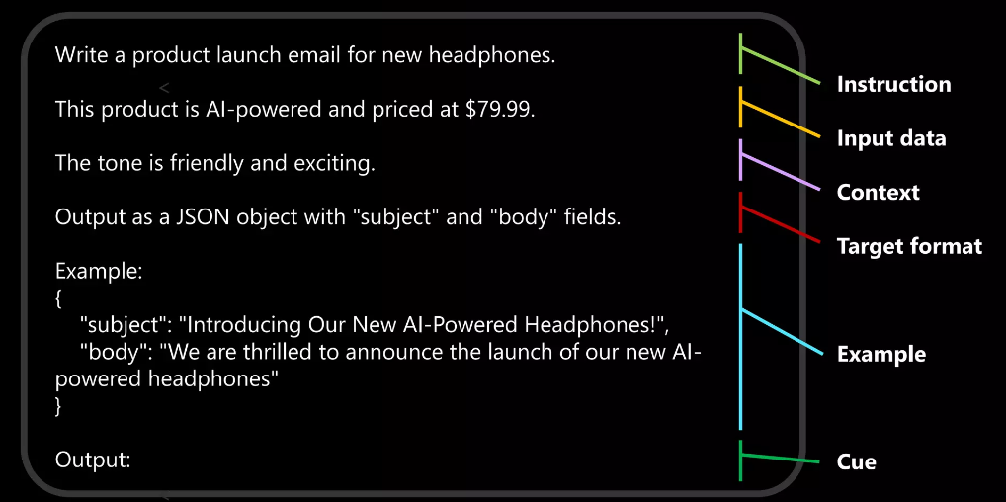
PROMPT ENGINEERING
Process of designing, refining, and optimizing input prompts to guide a model toward producing more accurate outputs while keeping cost efficiency
Prompt Anatomy

Slide 11
Challenges
Challenges in Prompting
Prompt Design
Striking the Balance Between Clarity and Specificity
Selection of Pre-trained Models
Zero shot leaning
One shot leaning
Few shot leaning
Context Dependence
Data Bias and Fairness
Cost Optimization
Evaluation Metrics

Slide 12

Methodology
The methodology employed in this research involves a systematic evaluation of LLMs' performance in document extraction
We outline the document extraction process, detailing the selected document types and the evaluation criteria and metrics used to assess the accuracy of LLMs in extracting information from these documents

Slide 13
Request flow of LLM based Extraction
Data Extraction Flow with LLM
1. PDF Conversion (OCR):
Convert PDF to plain text using OCR engine
2. Chunking Text for LLM:
Break down extracted text into manageable chunks for LLM processing
3. Prompt Crafting & Combining:
Design prompts to guide LLM in extracting specific data points
Combine prompts with corresponding text chunks
4. LLM Processing & JSON Output:
LLM processes prompts and text chunks to extract data
Extracted data is formatted as JSON for easy application integration
This automates business processes involving form data extraction
Request flow of LLM based Extraction (Yke Rusticus 2023).

Slide 14
Implementation - Data Preparation
Identify The Target Document
Collect Sample
Generate OCR Text
Generate Prompt Outline
Generate Prompt
Sample Prompt
```plaintext
{DOCUMENT_CONTEXT}
+
{TASK_DESCRIPTION}
+
{SCHEMA_REPRESENTATION}
```

Slide 15
LLM based Extractor Flow
Document Data Extraction Process Flow:
Document Categorization: The document is categorized to identify its type (e.g., W-2, W-8, W-9).
Prompt Template Retrieval: Based on the document category, a corresponding prompt template is retrieved. This template includes:
Document Context: Information about the type of document.
Standardized Task Description: A general description of the data extraction task.
Structured Schema Representation: A blueprint defining the expected format of the extracted data.
Prompt Construction: A specific prompt is crafted for the LLM by incorporating:
Document Context: Information from the retrieved template.
Detailed Task Description: Specifies the entities to be extracted from the document.
Schema Representation: Defines the structure for the extracted data.
LLM Processing: The constructed prompt is sent to the LLM (in this case, OpenAI's ChatGPT) through a chatbot API.
LLM Output: The LLM processes the prompt and generates an output containing the extracted data.
Output Evaluation: The extracted data is evaluated against the predefined schema representation to ensure it adheres to the expected structure and criteria.

Slide 16
Evaluation
Embedding-based Metrics
Qualitative Metrics
Employ word or sentence embeddings to measure semantic similarity between extracted data and source document.
Higher similarity indicates better extraction accuracy and quality.
Human experts assess extracted information for completeness, accuracy, and its relevance to the task.
Offers nuanced insights but can be time-intensive.
Human Evaluation
The most appropriate evaluation approach depends upon the intended use of the extracted data.
When the data is utilized for human analysis and decision-making, human expert evaluation becomes essential to ensure the results are both accurate and easily understood.

Slide 17
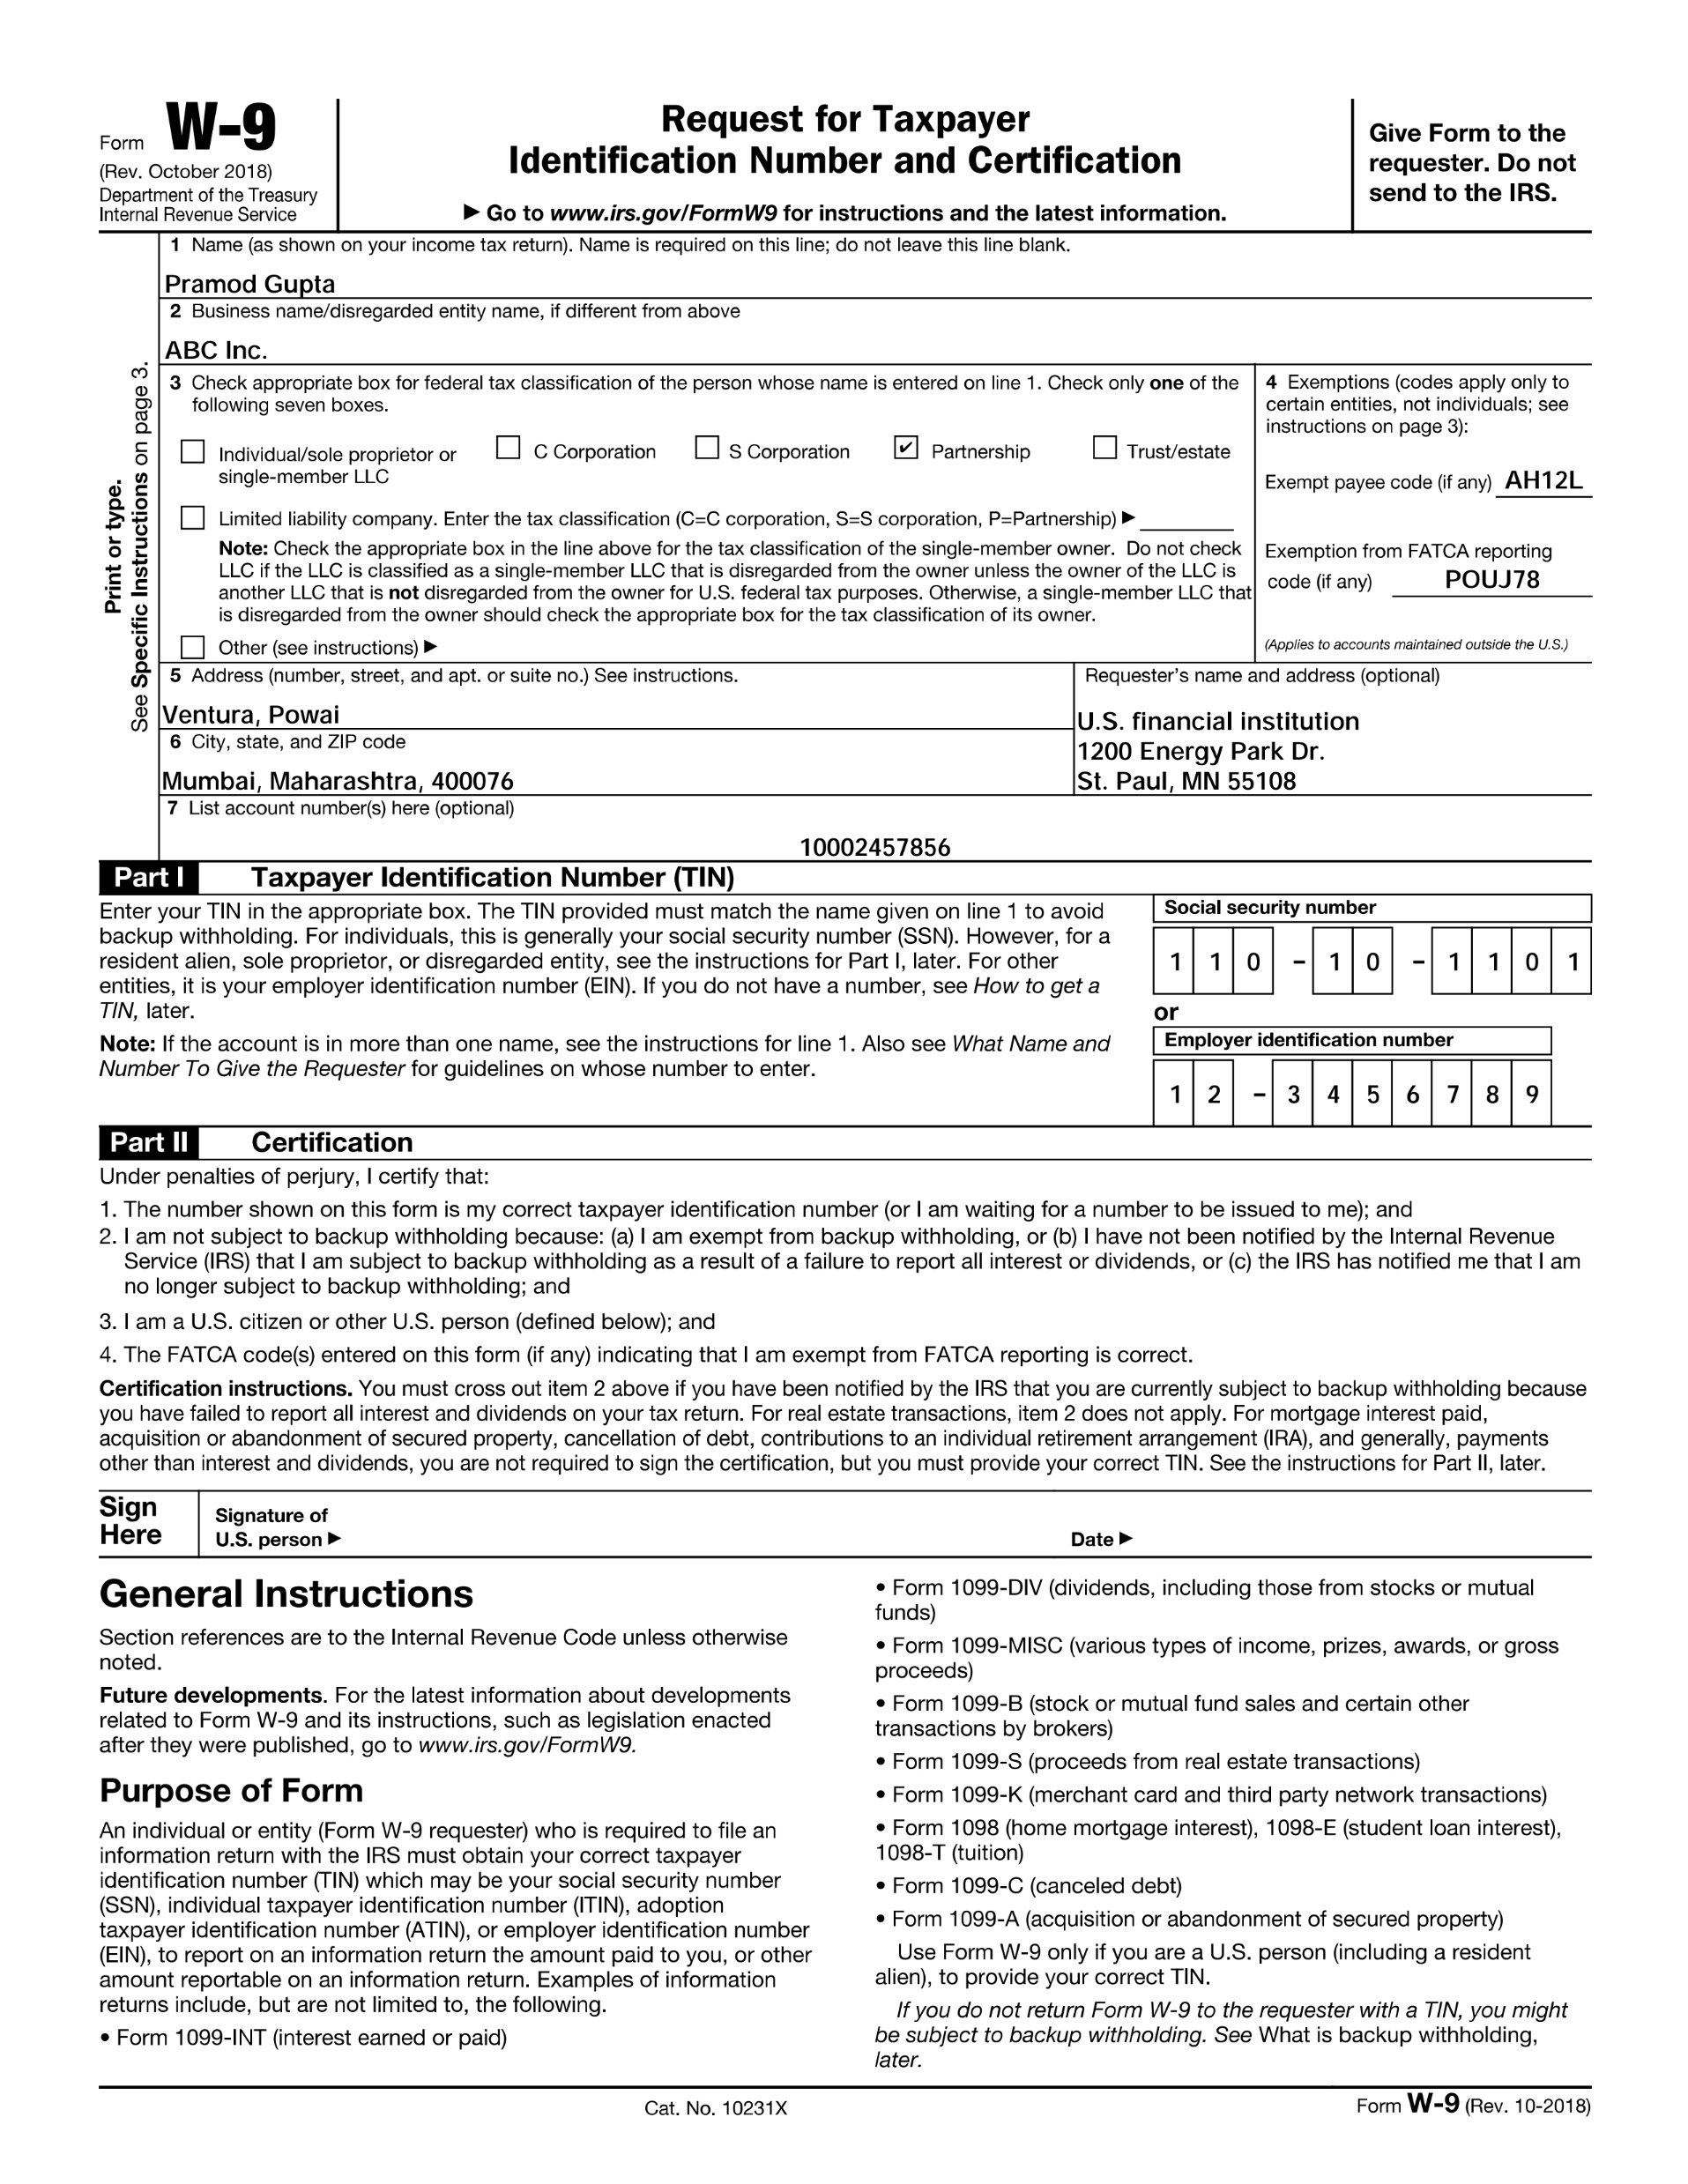
Results & Discussion – w9
Moving into the results and discussion section, we present the findings of the evaluation for the W9 form
This includes a detailed analysis of the accuracy of each LLM in extracting specific fields from the W9 form, such as business name, address, and social security number
Through this analysis, we gain insights into the performance nuances of different LLMs across varied document formats

Slide 18
Results & Discussion - W9
Model Accuracy
W9 Fields Accuracy Matrix

Slide 19
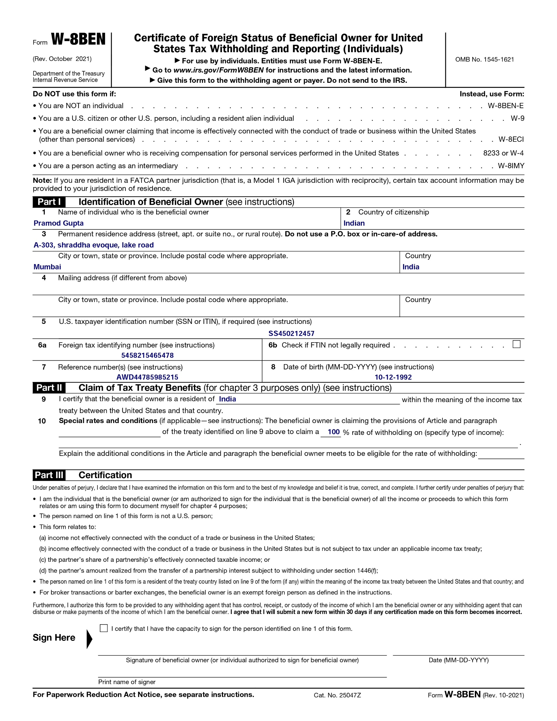
Results & Discussion – w8
Continuing our exploration, we shift the spotlight to the results and discussion for the W8 form
Here, we present a comprehensive analysis of each LLM's accuracy in extracting data from the W8 form, including fields such as name, country of citizenship, and foreign tax identifying number
By comparing the performance of LLMs across different document types, we uncover valuable insights into their capabilities and limitations

Slide 20
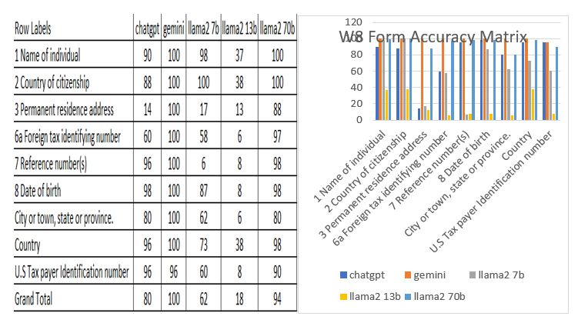
Results & Discussion - W8
Model Accuracy
W8 Fields Accuracy Matrix

Slide 21
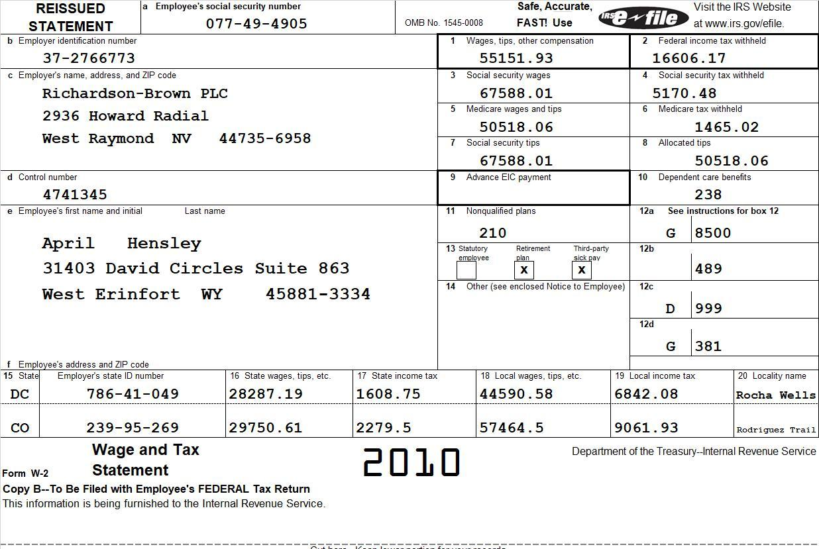
Results & Discussion
In the final segment of the results and discussion section, we turn our attention to the evaluation of the W2 form
This entails a thorough examination of each LLM's accuracy in extracting information from the W2 form, covering fields such as employer identification number, social security number, and total wages
Through this analysis, we gain a holistic understanding of LLM performance in document extraction within financial contexts

Slide 22
Results & Discussion - W2
Model Accuracy
W2 Fields Accuracy Matrix

Slide 23
Conclusion & Future Recommendations
Top Performers
Strengths
Room for Improvement
Conclusion
LLMs like ChatGPT and Gemini consistently achieved the highest accuracy
These models excelled particularly at extracting names, social security numbers, wage totals (W2), citizenship and address information (W8), and names and account numbers (W9).
Accuracy still varies across LLMs and data fields. More complex details, such as addresses and intricate financial data, remain challenging for all models.
Refine LLM Training
Ensemble Learning
Human-in-the-Loop
Explainability and Bias
Expand Scope
Real-World Applications
Future Recommendation

Slide 24
Thank You

